Slide 1
EASTER

Slide 2
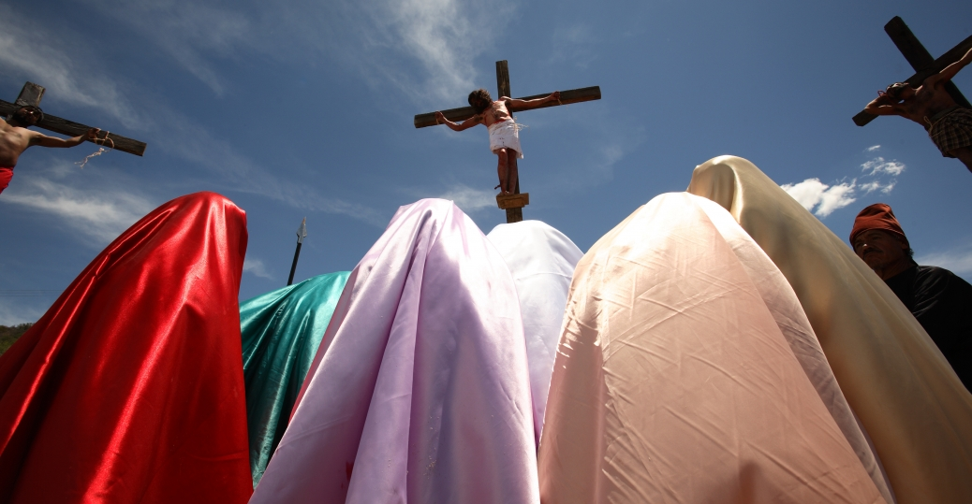
Easter is called a moveable feast because it doesn’t fall on a set date every year. Instead, Christian churches in the West celebrate Easter on the first Sunday following the full moon after the vernal equinox on March 21. So Easter is anywhere between
March 22 and
April 25 every
year.

Slide 3
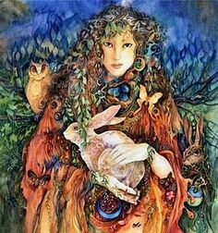
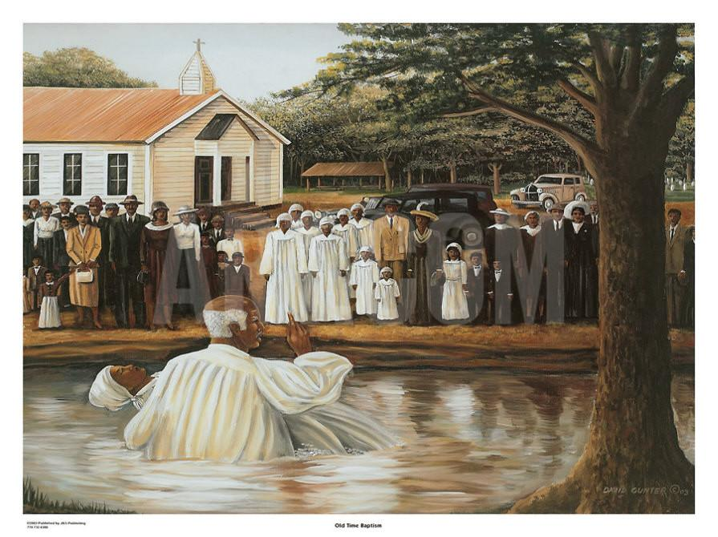
The word Easter probably came from Eostre, a Teutonic goddess of spring and fertility. Other accounts trace Easter to the Latin term hebdomada alba, or white week, an ancient
reference to Easter week
and the white clothing
donned by people who
were baptized during
that time.

Slide 4
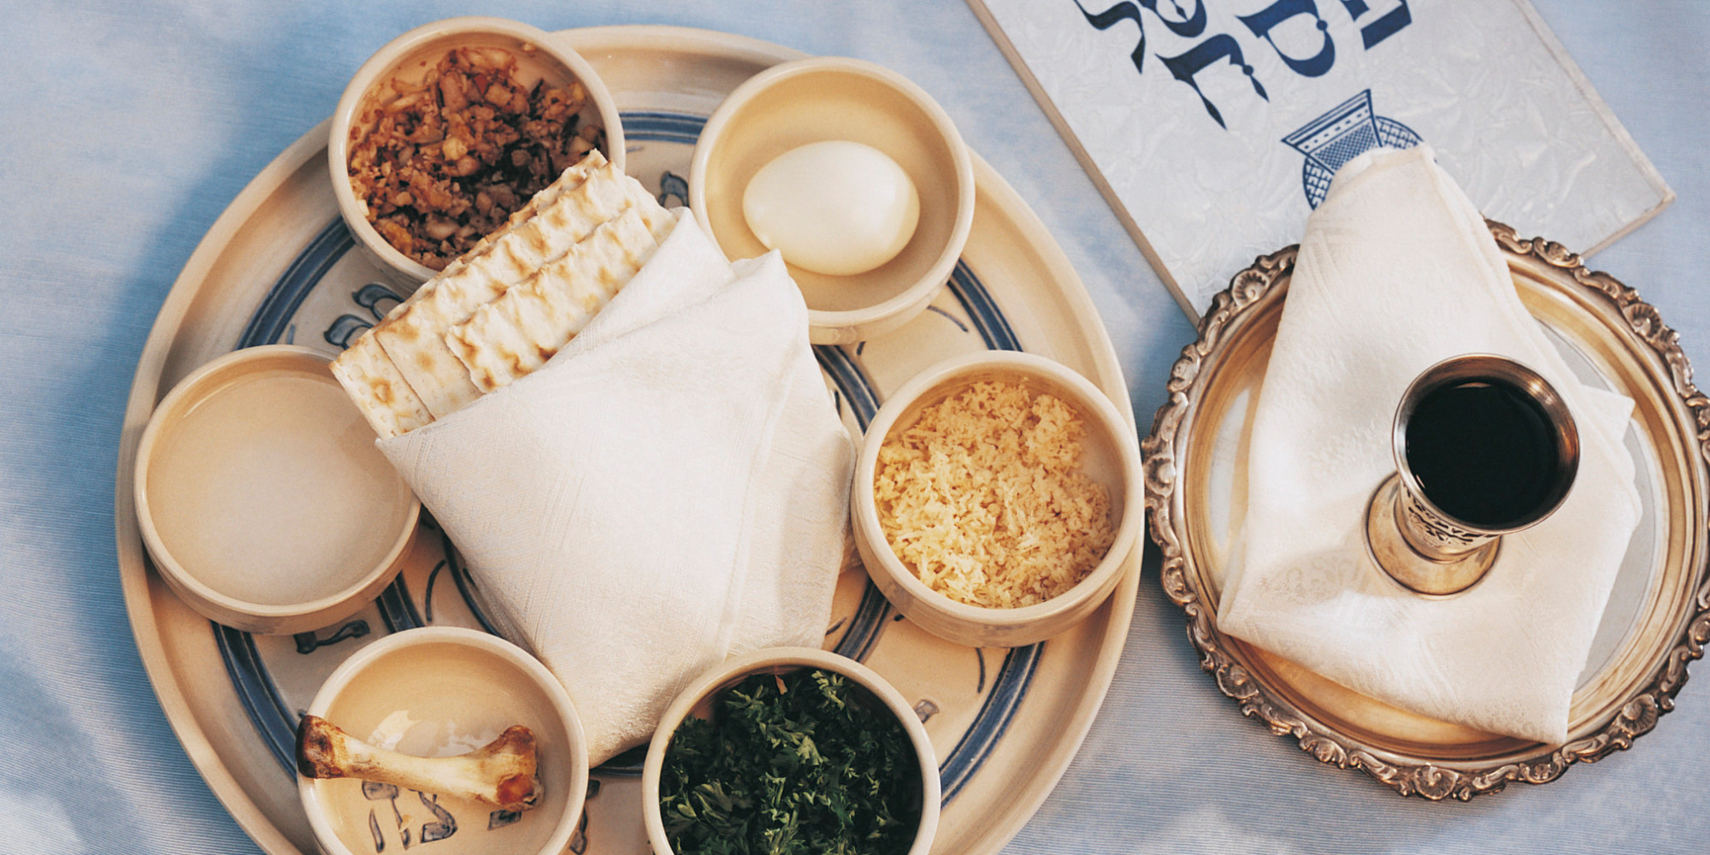
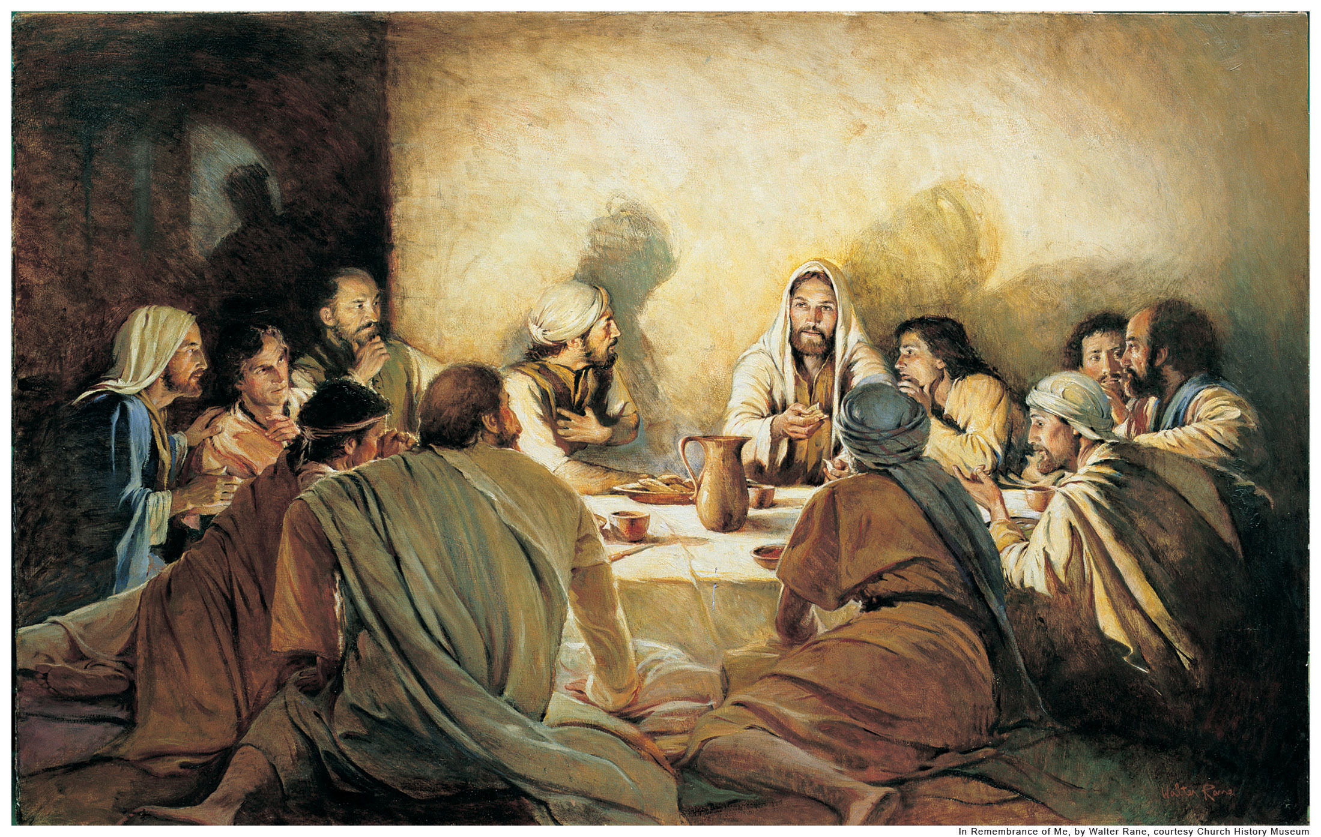
Through a translation error into Old High German, it eventually became Easter in English.
Pascua; Paques: derived from the Greek and Latin Pascha or Pasch, for Passover.
Jesus’ crucifixion and resurrection occurred after he went to Jerusalem to celebrate Passover, the Jewish festival remembering the ancient Israelites’ exodus from slavery in Egypt. Pascha eventually came to mean Easter.

Slide 5
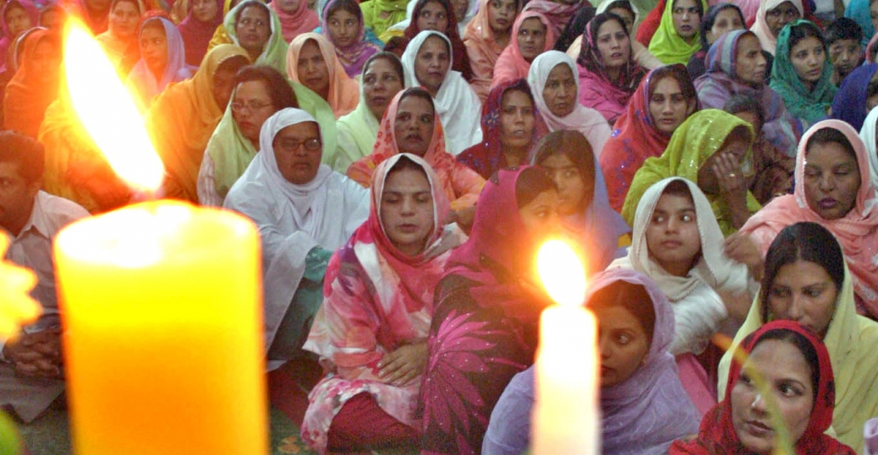
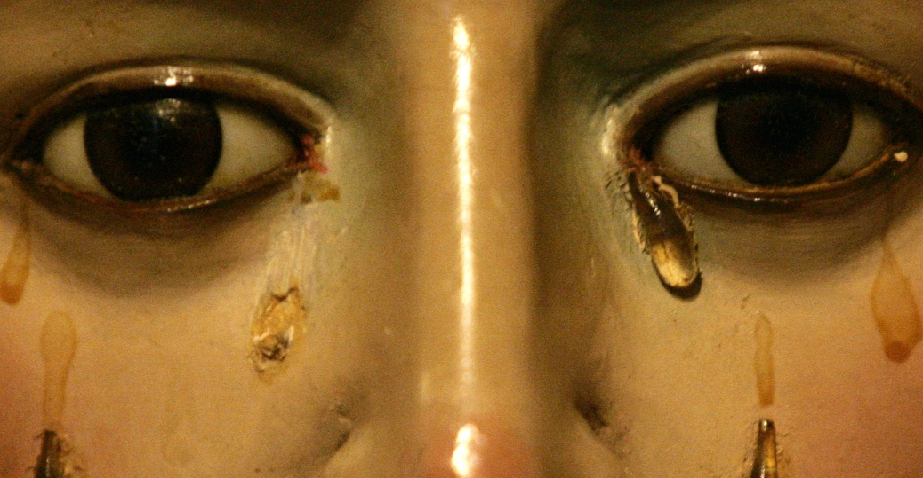
Lent represents the 40 days that Jesus spent alone in the wilderness before starting his ministry, a time in which Christians believe he survived various temptations by the devil.
Easter is really an entire season of the Christian church year, as opposed to a single-day observance. Lent, the 40-day period leading up to Easter Sunday, is a time of reflection and penance.

Slide 6
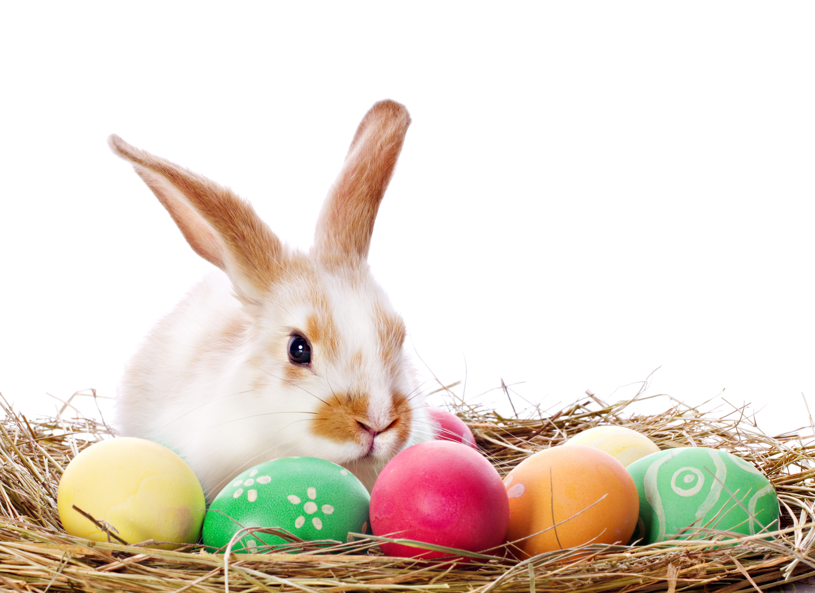
The exact origins of this mythical mammal are unclear, but rabbits are an ancient symbol of fertility and new life. We think the Easter bunny first arrived in America in the 1700s with German immigrants who settled in Pennsylvania and transported their tradition of an egg-laying hare. Their children made nests in which this creature could lay its colored eggs, and eventually, expanded to include chocolate and other types of candy and gifts, while decorated baskets replaced nests.

Slide 7
Easter is a religious holiday, but some of its customs, such as Easter eggs, are likely linked to pagan traditions. The egg, an ancient symbol of new life, has been associated with pagan festivals celebrating spring. Decorating eggs for Easter is a tradition that dates back to at least the 13th century, according to some sources. One explanation for this custom is that eggs were formerly a forbidden food during the Lenten season, so people would paint and decorate them to mark the end of the period of penance and fasting, then eat them on Easter as a celebration.

Slide 8
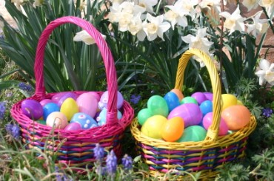
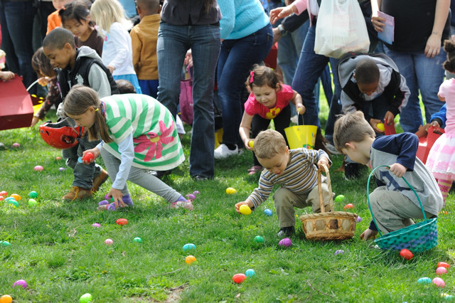
Easter Egg Hunts!

Slide 9
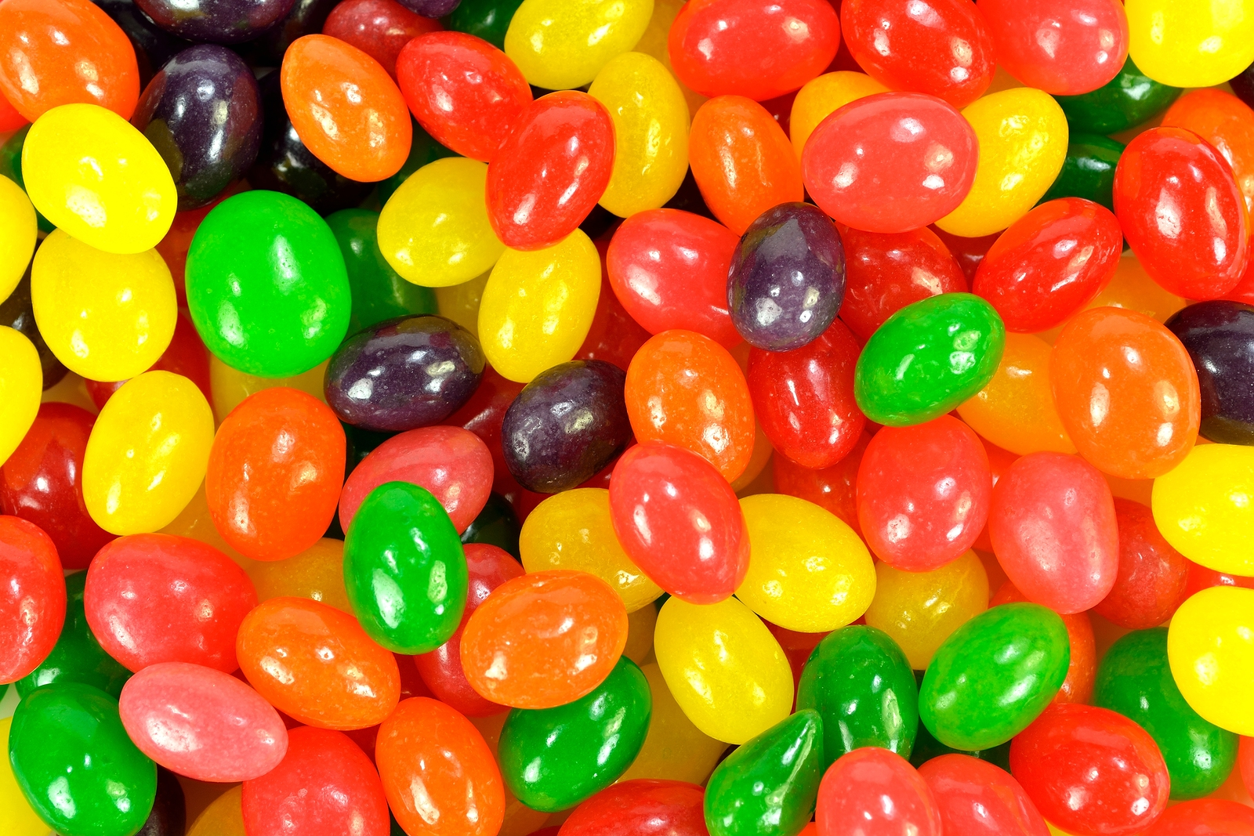
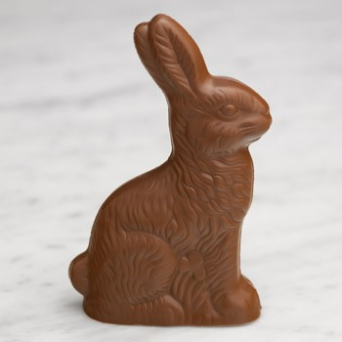
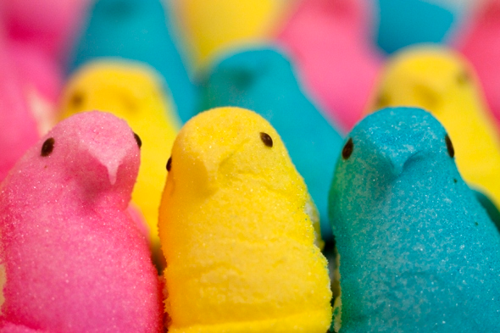
Easter is the second best-selling candy holiday in America, after Halloween. Among the most popular sweet treats associated with this day are chocolate eggs, which date back to early 19th century Europe.

Slide 10
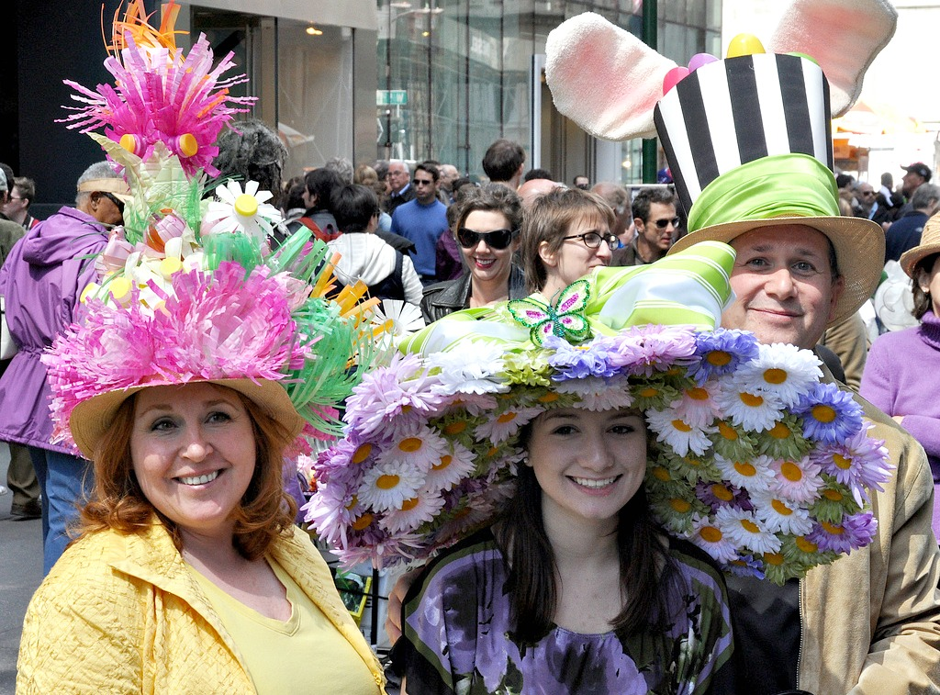
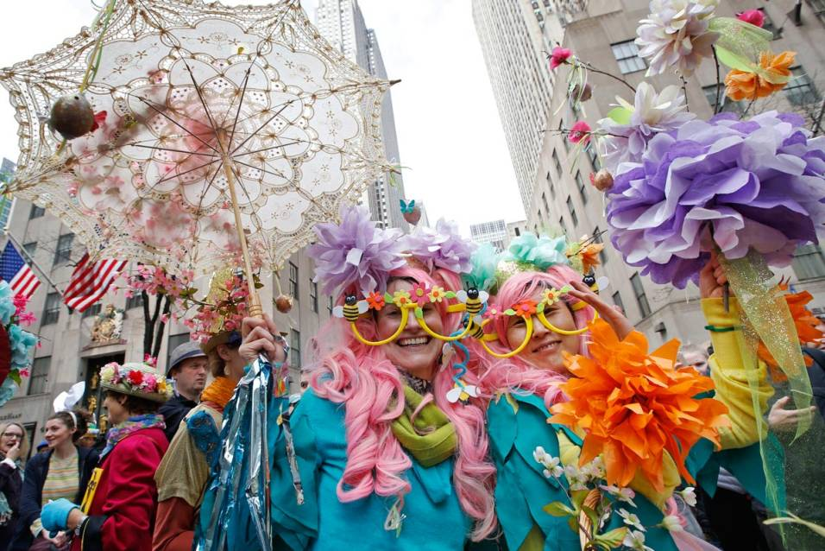
New York Easter Parade

Slide 11
Videos
http://www.history.com/topics/holidays/history-of-easter
http://www.history.com/topics/holidays/history-of-easter/videos/history-of-the-holidays-easter-video

